Slide 1
Learning to Track Instances without Video Annotations
Yang Fu, Sifei Liu, Umar Iqbal, Shalini De Mello, Humphrey Shi, Jan Kautz
CVPR 2021 (Oral)

Slide 2
Keywords
Instance tracking
Semi-supervised learning
Contrastive Learning
Maximum Entropy Regularization
Video Instance Correspondence
Test-time Adaptation

Slide 3
Main task : Video Instance Segmentation
Linjie Yang, et al., Video Instance Segmentation, ICCV 2019

Slide 4
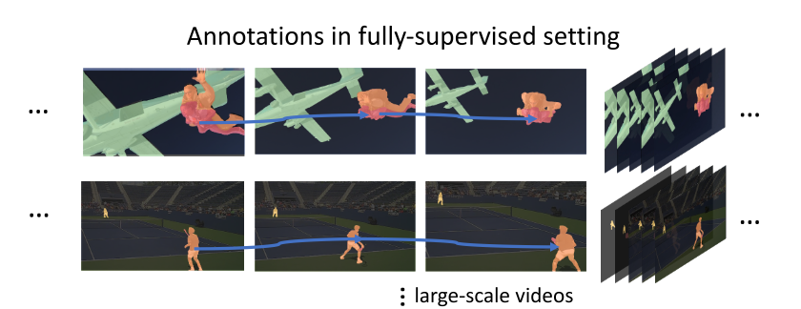
Problem Statement
How to learn to track instances without annotation in video
Annotation of videos requires excessive labor especially in a per-frame manner and becomes the major bottleneck for framewise video processing

Slide 5
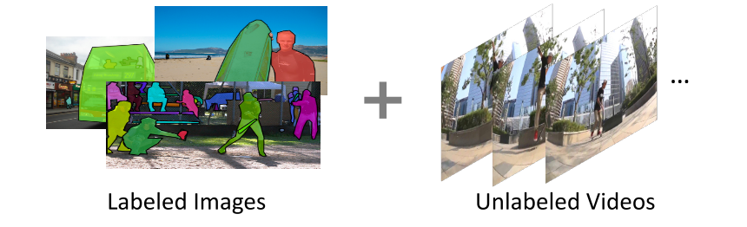
How to solve the Problem
Trained with images in a supervised manner
Enhance the tracking capability of the embedding by learning correspondence from unlabeled videos in a self-supervised manner

Slide 6
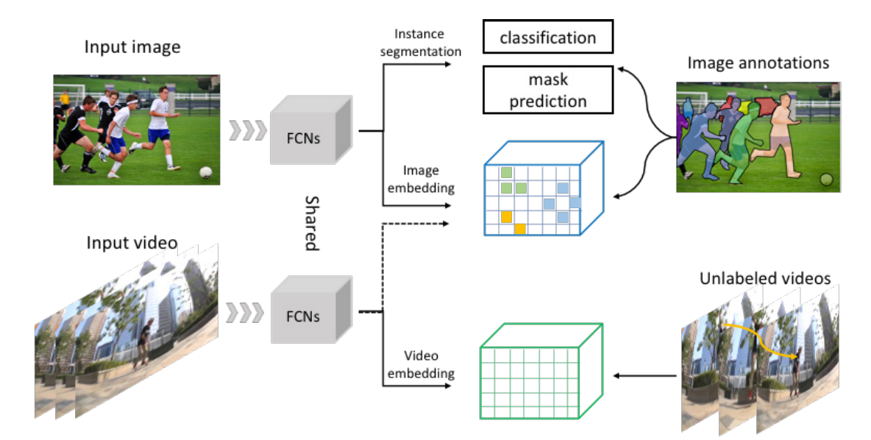
Proposed Method

Slide 7
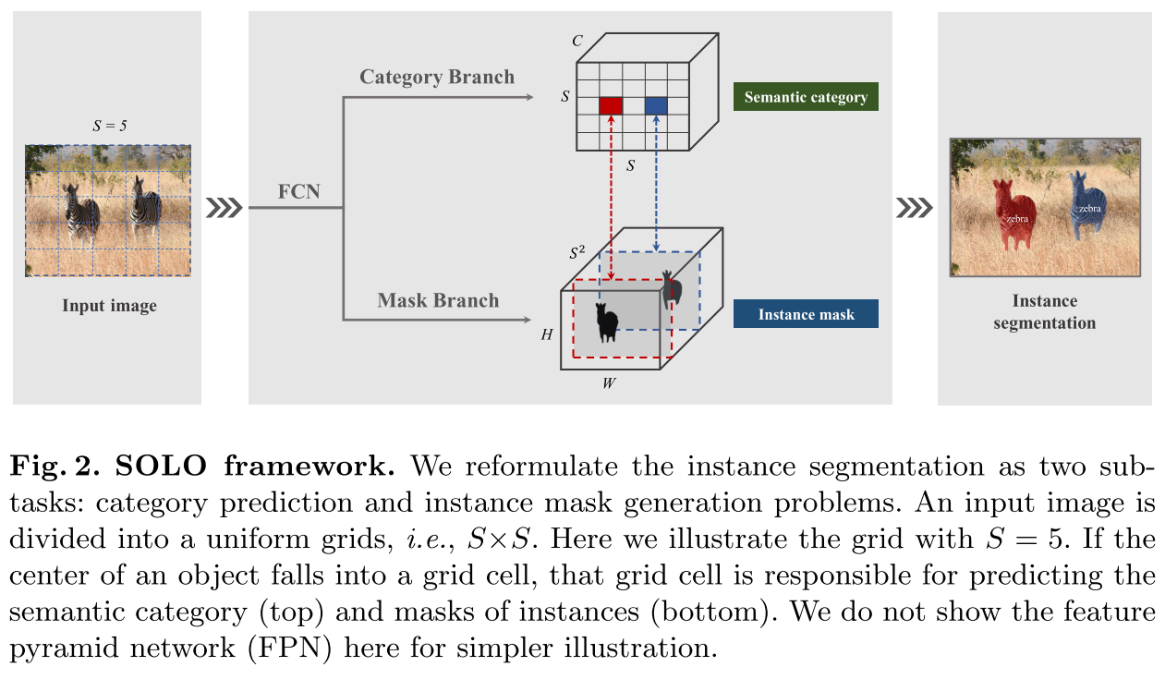
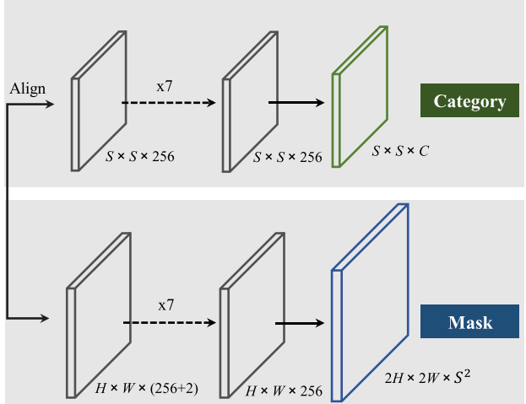
Backgrounds : SOLO
Details in Category Branch and Mask Branch
Xinlong Wang, et al., Solo: Segmenting objects by locations, ECCV 2020

Slide 8
Proposed Method

Slide 9
Proposed Method
Why it needs image, video embedding part? As assigning ids to each object, the model need to know each instance so that it can track those possible
How to learn embedding efficiently
discriminative of different instances
consistent regardless of the variations present in videos.
focus more on appearance rather than location, since objects can move in time.

Slide 10
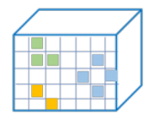
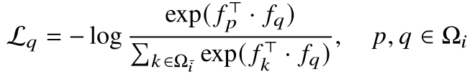
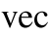
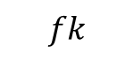
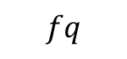
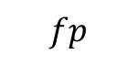
Proposed Method : Image embedding (Instance Contrastive Loss)
$$fp$$
$$fq$$
Objective : discriminative of different instances
Solution : Contrastive Loss
$$fk$$
Aaron van den Oord et al., Representation learning with contrastive predictive coding. arXiv 2018

Slide 11
Proposed Method : Image embedding (Instance Contrastive Loss)
$$fp$$
$$fq$$
Objective : discriminative of different instances
Solution : Contrastive Loss
Smaller instances will be insufficiently trained due to less positive samples !
$$fk$$
Aaron van den Oord et al., Representation learning with contrastive predictive coding. arXiv 2018

Slide 12
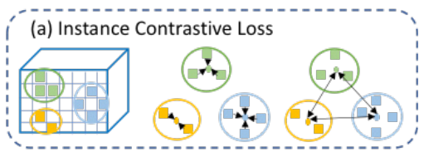
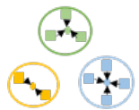
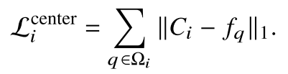
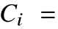
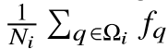
Proposed Method : Image embedding (Instance Contrastive Loss)
Force the embedding feature vectors of the same instance to be similar

Slide 13
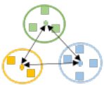
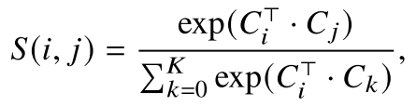
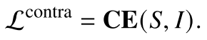
Proposed Method : Image embedding (Instance Contrastive Loss)
Push the center representation of all the instances further apart

Slide 14
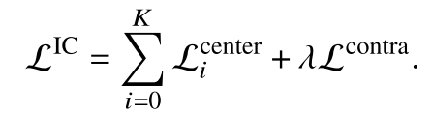
Proposed Method : Image embedding (Instance Contrastive Loss)

Slide 15
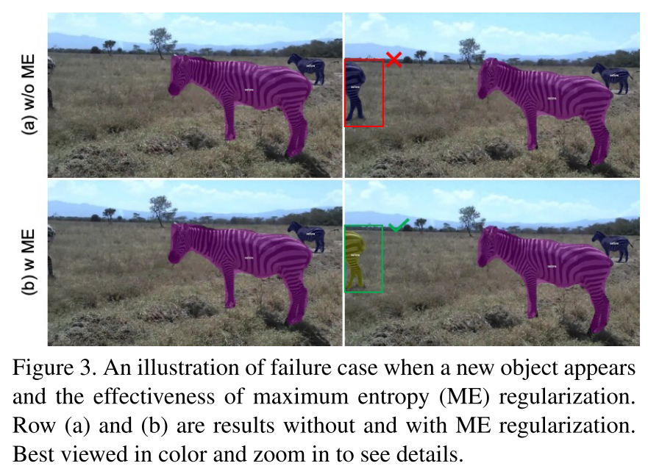
Proposed Method : Image embedding (maximum entropy regularization)
Our tracking approach is based on the assumption that any instance in the current frame also exists in the previous frame.
It doesn’t consider newly emerged objects.

Slide 16
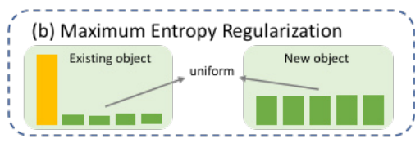
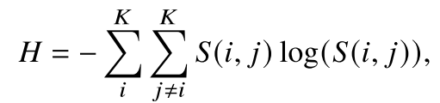
Proposed Method : Image embedding (maximum entropy regularization)
K is the number of instances and S(i,j) is the probability of matching instance i to j
High entropy H indicates uniform output probability

Slide 17
Proposed Method

Slide 18
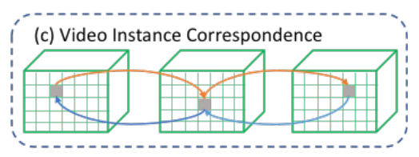
Proposed Method : Video embedding (Video Instance Correspondence)
With videos, we also need to address the domain gap that usually exists between image and videos
Solution : self-supervised video correspondence learning

Slide 19
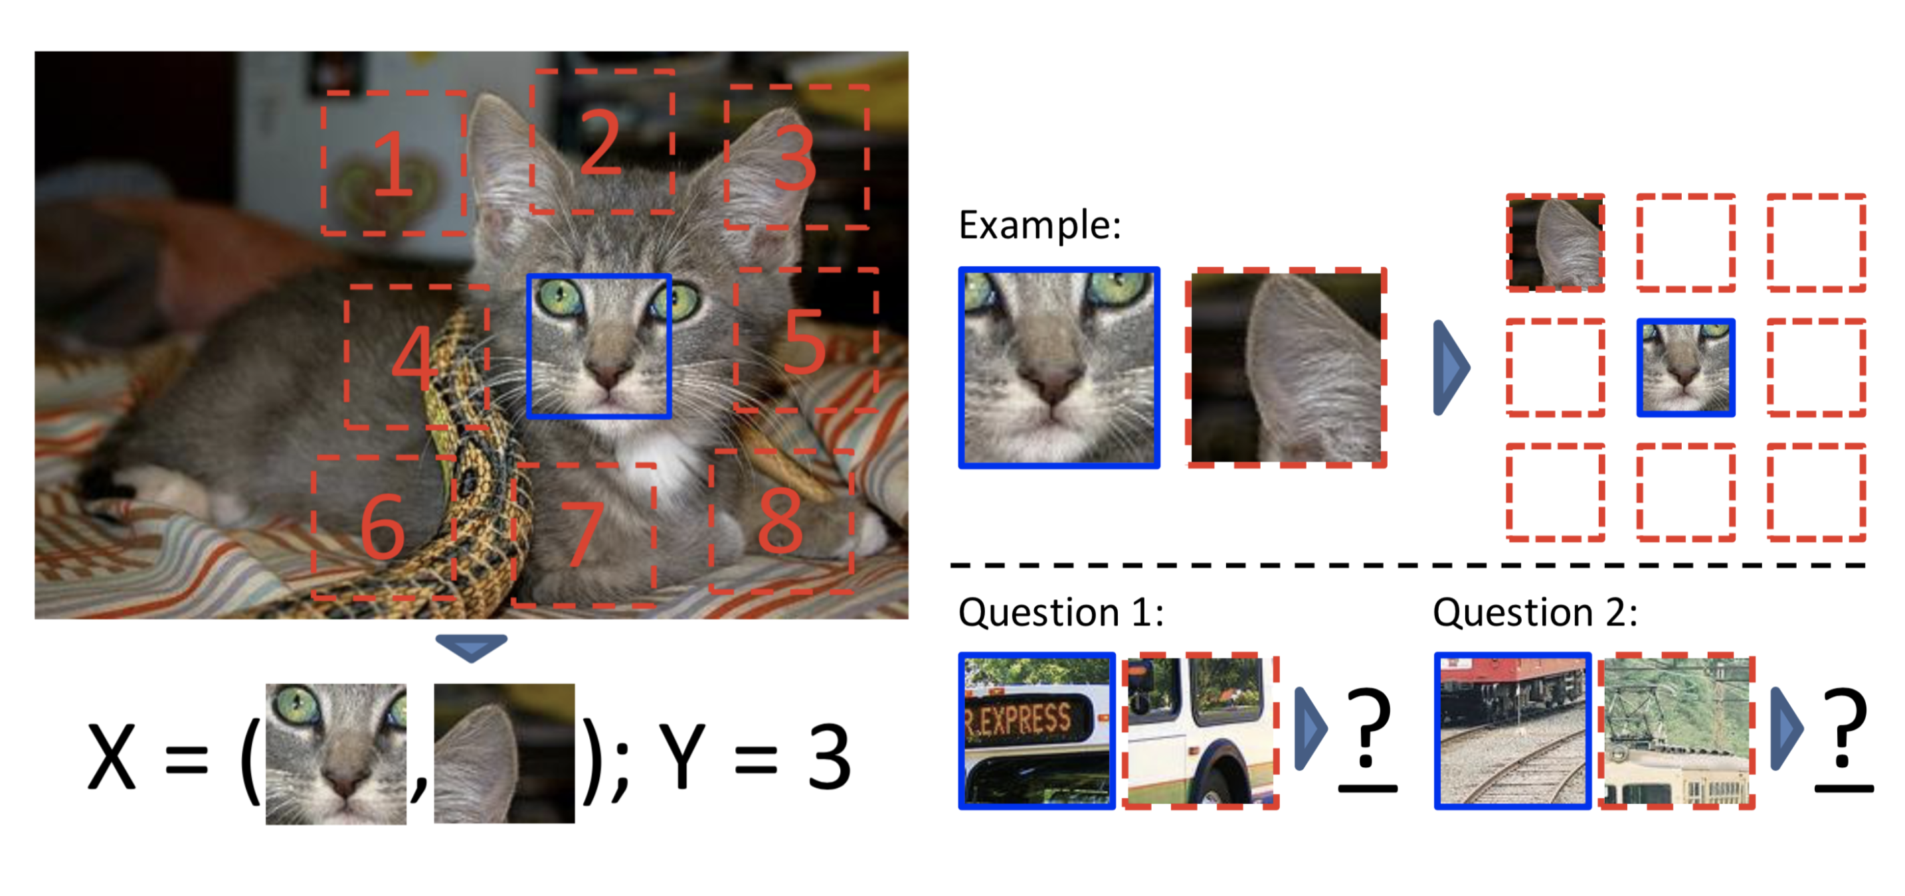
Background : Self-supervise learning
Pretext task: get supervision from the data itself
Self-supervised representation learning care about producing good features generally helpful for many tasks
Carl Doersch ,et al. Unsupervised Visual Representation Learning by Context Prediction. ICCV 2015

Slide 20
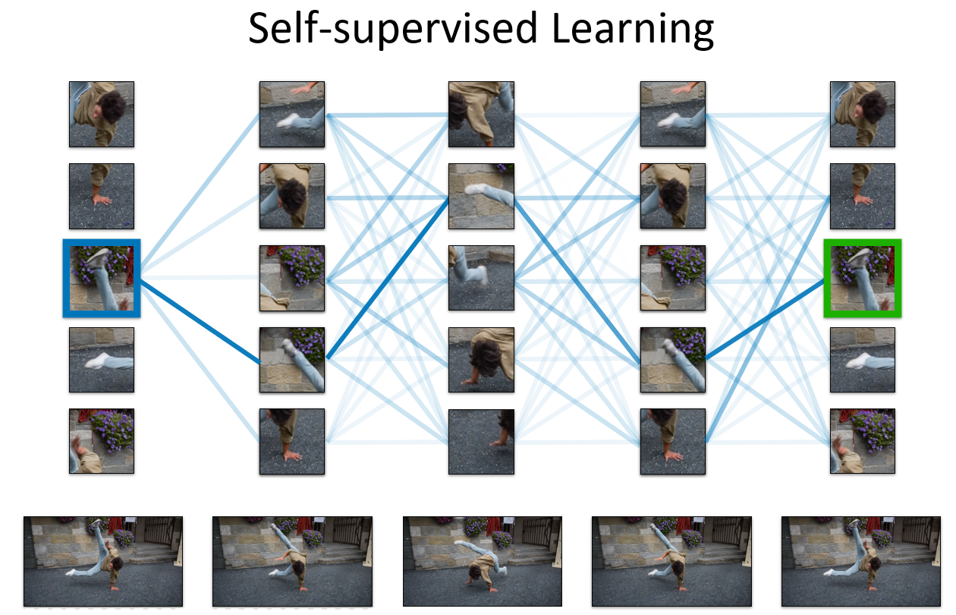
Proposed Method : Video embedding (Video Instance Correspondence)
Allan Jabri ,et al. Space-Time Correspondence as a Contrastive Random Walk. NeurIPS 2020, Oral

Slide 21
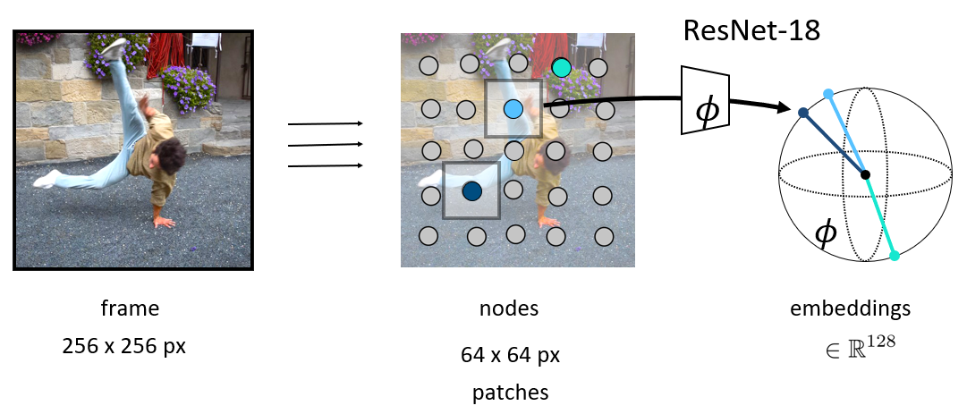
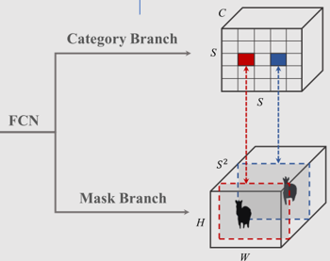
Proposed Method : Video embedding (Video Instance Correspondence)
Allan Jabri ,et al. Space-Time Correspondence as a Contrastive Random Walk. NeurIPS 2020, Oral

Slide 22
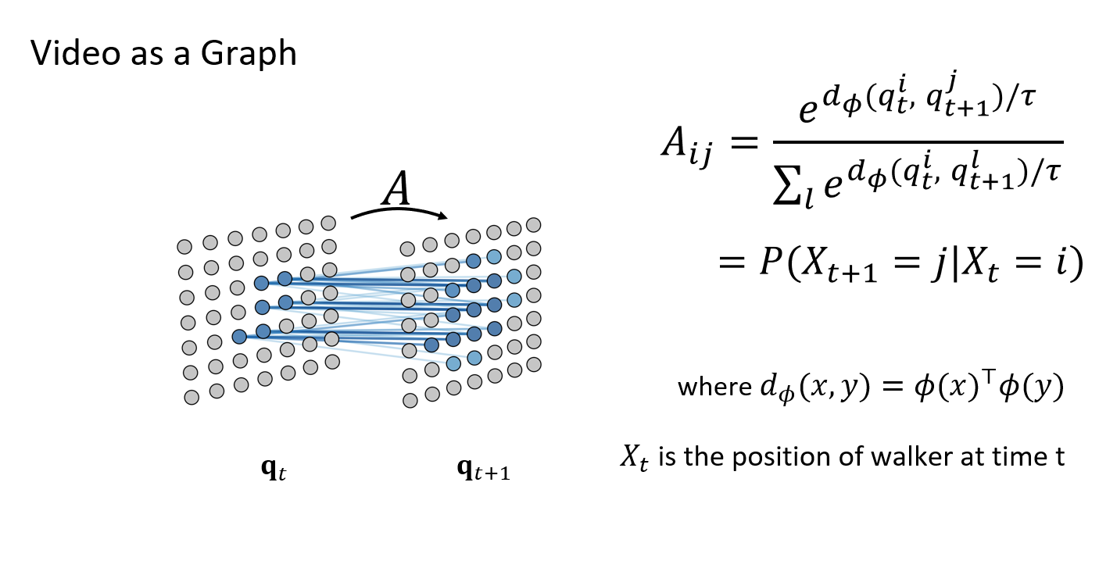
Proposed Method : Video embedding (Video Instance Correspondence)
Allan Jabri ,et al. Space-Time Correspondence as a Contrastive Random Walk. NeurIPS 2020, Oral

Slide 23
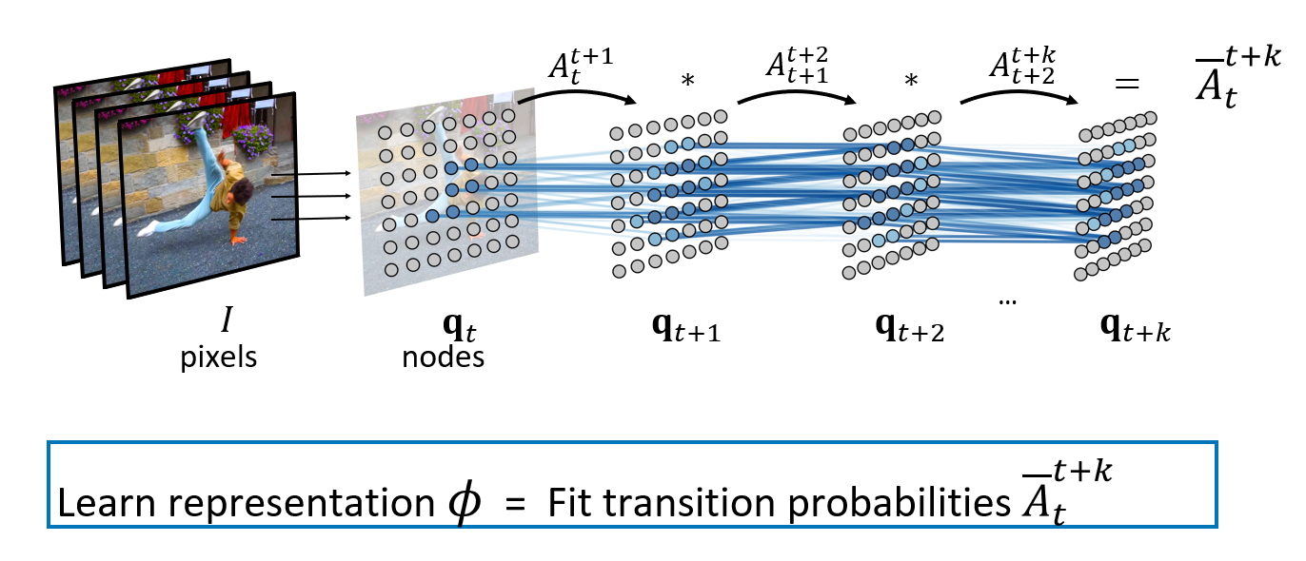
Proposed Method : Video embedding (Video Instance Correspondence)
Allan Jabri ,et al. Space-Time Correspondence as a Contrastive Random Walk. NeurIPS 2020, Oral

Slide 24
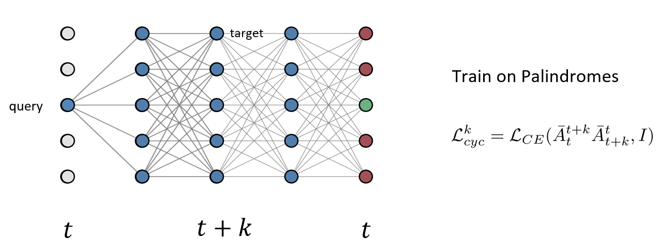
Proposed Method : Video embedding (Video Instance Correspondence)
Allan Jabri ,et al. Space-Time Correspondence as a Contrastive Random Walk. NeurIPS 2020, Oral

Slide 25
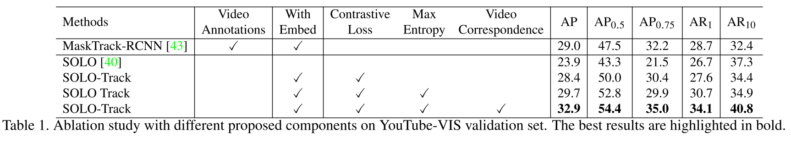
Results

Slide 26
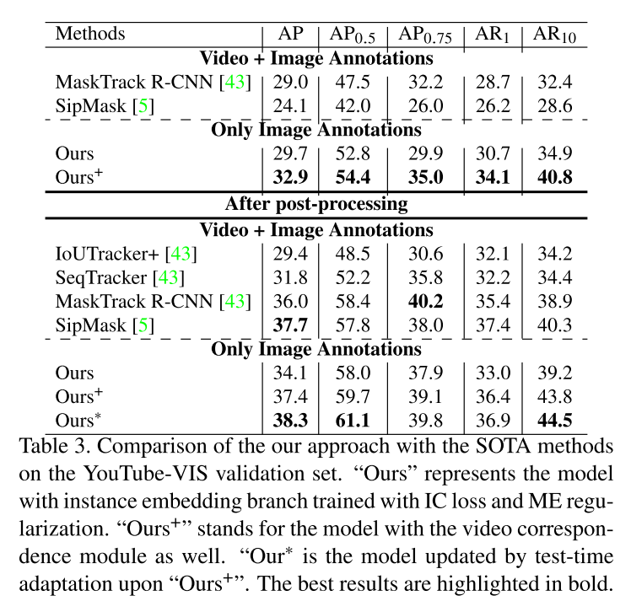
Results

Slide 27
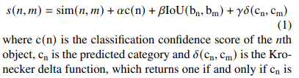
Supplementary
Post Processing we also apply the post-processing procedure introduced in, which combines category confidence, bounding box Intersection over Union (IoU), embedding similarity and category consistency through a weighted sum.

